Slide 2
HRU ECO 150
Mechanical Ventilation with Heat Recovery

Slide 3
HRU ECO 150, specifications
Capacity
  150 m3/h @ 150 Pa, 170 m3/h @ 100 Pa
Power consumption
  Max. 90W, SFP 0,37 W/l/s (at 15 l/s)
Thermal efficiency
  Upto 91%
Duct connections
  4 x Ø125 mm
Dimensions
  786 x 597 x 290 mm

Slide 4
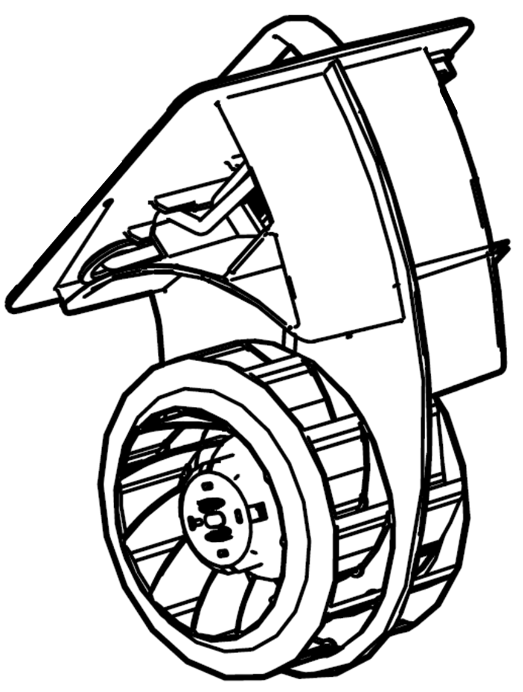
HRU ECO 150, specifications
1 fanmotor, 2 fanblades
100% integrated, automatic bypass
Easy frost protection
Turbo speed and low speed adjustable with potentiometers
Standard G3 filter, optional G4 en F7
Standard RF receiver integrated
Prepared for RF-sensors, CO₂, RH en PIR

Slide 5
HRU ECO 150, dimensions

Slide 6
HRU ECO 150, models and main components
Models
  HRU ECO 150 E, 2 wired cable
  HRU ECO 150 P, 4 wired cable
Main components
Number | Description
1 | Complete MVHR unit
2 | Fan module
3 | Duct connection - unit side
4 | Mounting bracket
5 | Duct connection - duct side
6 | Wire bracket
7 | Filter
8 | Filter cover
9 | Ceiling mounting bracket

Slide 7
HRU ECO 150, condensate drain connection
2 condensate drains at bottem side
  Ceiling / floor mounting lowest connection
  Wall mounting as best suits
Hose in siphon with min. 50 mm
airlock
Diameter condensate hose:
  Int. Ø 14 mm
  Ext. Ø 18 mm
When installed in a non insolated room →
Insolate also the condensate hose

Slide 8

HRU ECO 150, ductconnections
Fresh air from outside
Stale air to outside
Fresh air to inside
Stale air from inside

Slide 9
HRU ECO 150, mounting options
Wall mounting Floor mounting Ceiling mounting

Slide 10
HRU ECO 150, mirrored mounting
You can change the duct connections to and from outside from left to right by moving and turning the connections

Slide 11
HRU ECO 150, wall mounting

Slide 12
HRU ECO 150, ceiling mounting

Slide 13
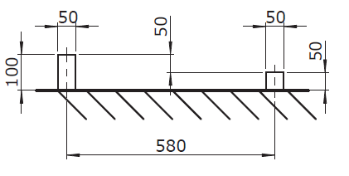
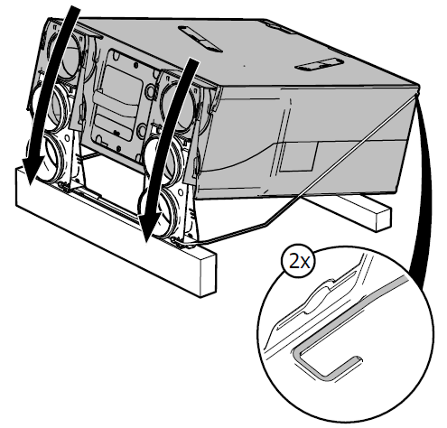
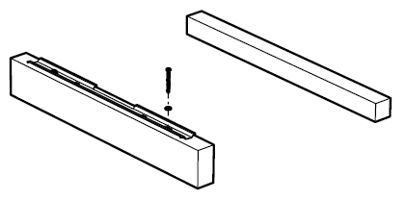
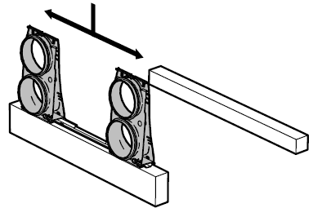
HRU ECO 150, floor mounting

Slide 14
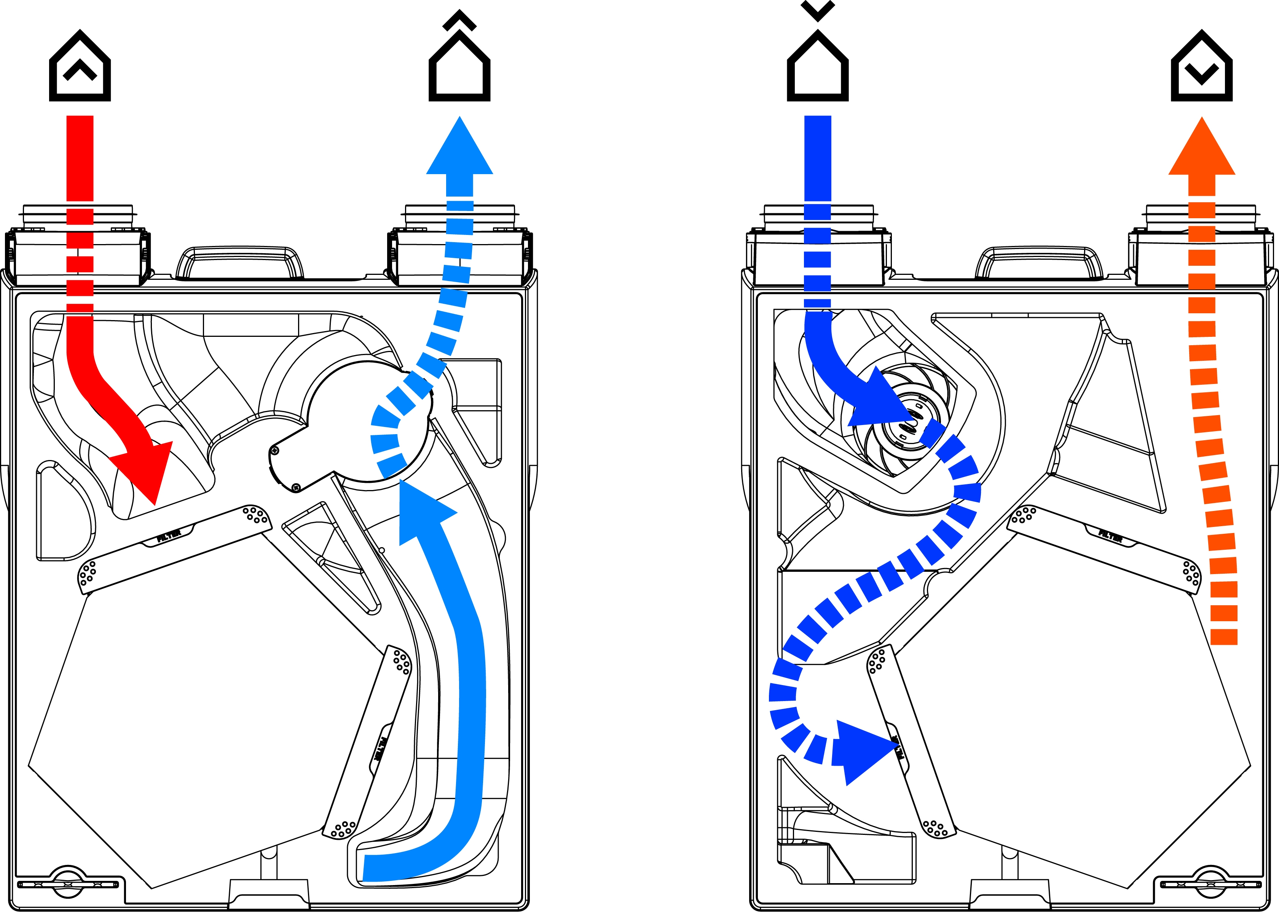
HRU ECO 150, heat recovery mode

Slide 15
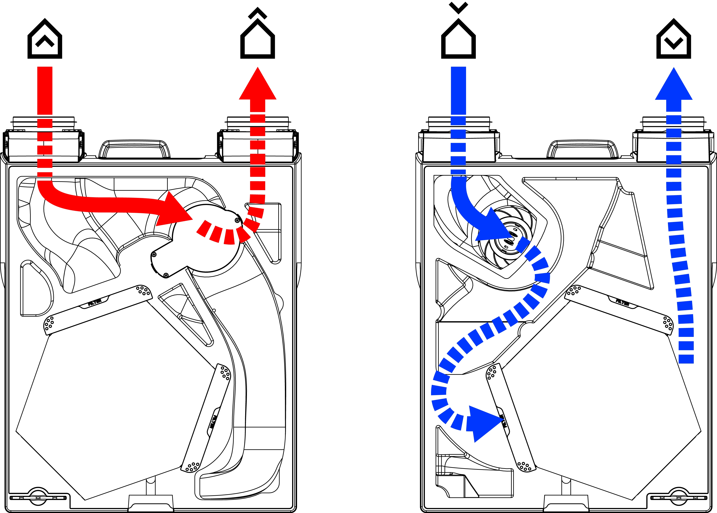
HRU ECO 150, bypass mode

Slide 16

HRU ECO 150, animation bypassklep

Slide 17
HRU ECO 150, frost protection functionality
During “fan off” unit will follow the Timer command at the RF control

Slide 18
HRU ECO 150, accessoires
Adapter duct connection (under construction)
  Insolated adapter for EPP ducting
  Diameter Ø 125mm
Electrical pre heater as frost protection (under construction)
  500W 230V 50Hz Europlug
  Max flow 150 m³/h
  Thermal insolated
  Adjustable between +5°C tot -10°C
  Independant from flow direction
  Flow and temperature protection

Slide 19
HRU ECO 150, electrical connection
4-wired cable

Slide 20
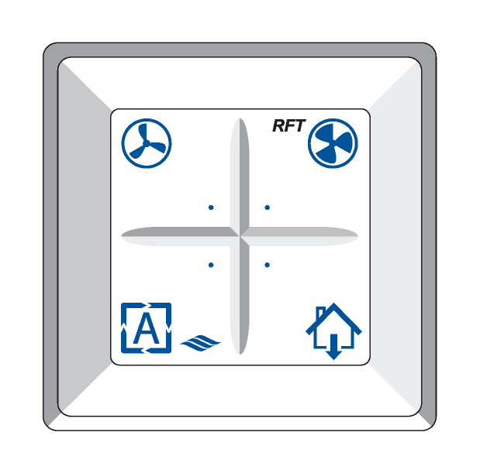

HRU ECO 150, wired control
Low position
  Fanspeed according to setting potmeter low
Midle position
Fanspeed as calculated between setting potmeter low and
boost (If a sensor is installed, this is the automatic position)
Boost
  Fanspeed according to setting of potmeter boost

Slide 21

HRU ECO 150, wireless RF- control standard
Low position
  Fanspeed according to setting potmeter low
Midle position
  Fanspeed as calculated between setting potmeter low and
  boost (If a sensor is installed, this is the automatic position)
Boost
  Fanspeed according to setting of potmeter boost
Timer
  Fanspeed according to boost for
    10, 20, 30 minutes
  Afterwards back to original position

Slide 22
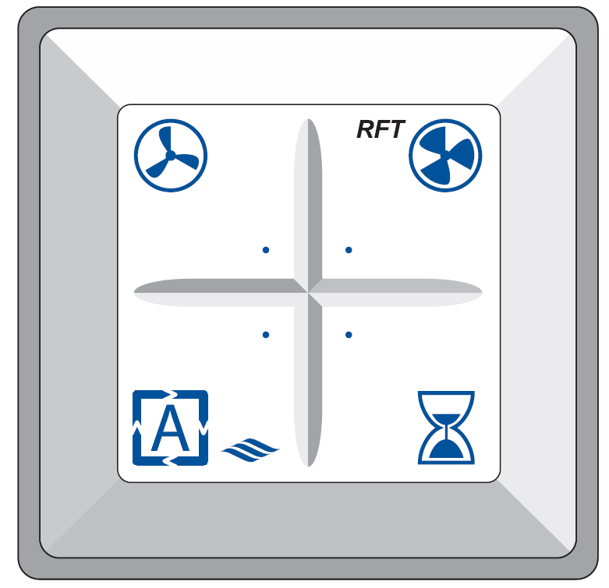
HRU ECO 150, wireless RF-control with sensor(s)
Manual operation low
  Fanspeed according to setting potmeter low (after 24 h back to automatic operation)
Manual operation boost (after 24 h back to automatic operation)
  Fanspeed according to setting potmeter boost
Automatic operation
  Fanspeed controlled by sensor(s)
Timer
  Fanspeed according to boost for
    10, 20, 30 minutes
  Afterwards back to original position

Slide 23
HRU ECO 150, dirty filter indication
HRU ECO 150 provided with a dirty filter indication
Hour counter which takes account of:
  Air quality
  Standing time of filter
  Fanspeed
Dirty filter message can be indicated at RF control type RFT-L, ventilation interface type RF-VI and Itho Daalderop HEVAC controller

Slide 24
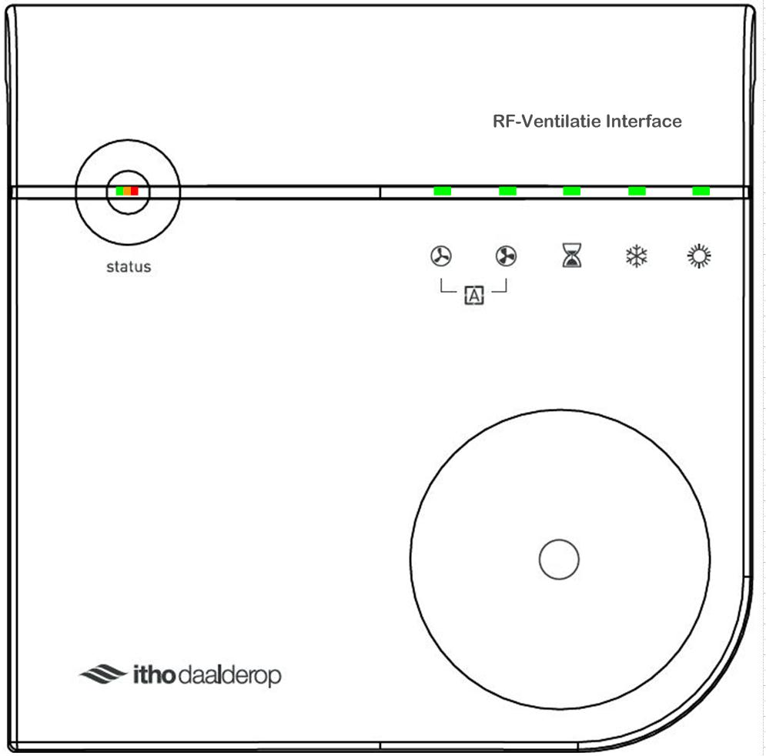
HRU ECO 150, ventilation interface RF-VI (under construction)
230V , RF communication with MVHR unit
Ventilation control
  Low, boost, automatically, timer
Status indication
  Bypass, frost control active
Operation status
  OK, message (f.i . dirty filter), error code

Slide 25
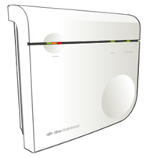

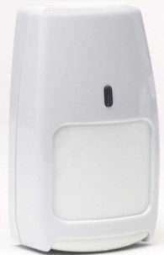
HRU ECO 150, wireless sensor(s)
RF-CO₂ sensor (air quality sensor)
  230V power supply
  RF communication with unit
  RF-CO₂ sensor for living or bedroom
RF-RH sensor (humidity sensor)
  Battery powered
  RF-communication with unit
  RF-RH sensor voor de bathroom or utility room
RF-PIR sensor (movement sensor)
  Battery powered
  RF-communication with unit
  RF-PIR sensor for toilet / bathroom with toilet

Slide 26
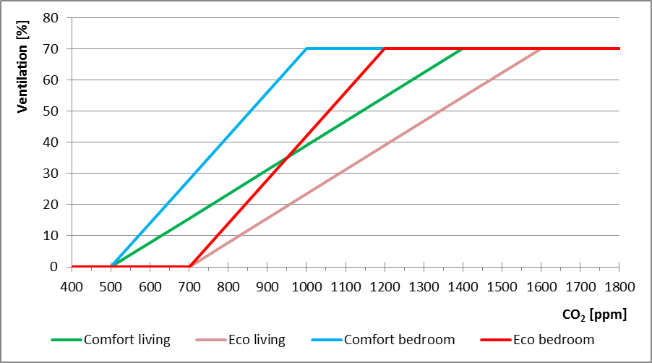
HRU ECO 150, wireless CO₂ sensor
Setting for Eco and Comfort
Setting for living area and sleeping area

Slide 27
HRU ECO 150, wireless RH sensor bathroom
Fan speed to boost (high speed)
  Quick increase of the relative humidity (>3% in 24 seconds)
  RH > 85%
  Boost mode for minimal 20 minutes
A: Initial RH
B: Start ventilation
C: Stop ventilation (RH decrease)
D: Stop ventilation (time passed)
RH
time

Slide 28
HRU ECO 150, wireless RH sensor bathroom
Fan speed back to original mode
  After decrease of RH to < 82% and
  RH < original level + 10% or
  Change in RH < +/- 3% within 15 minutes
A: Initial RH
B: Start ventilation
C: Stop ventilation (RH decrease)
D: Stop ventilation (time passed)
RH
time

Slide 29
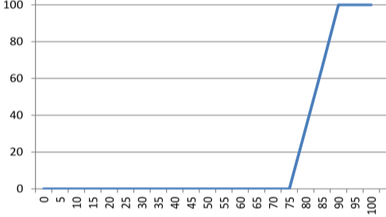
HRU ECO 150, wireless RH sensor utility room
If RH level increase > 75% fanspeed will gradualy increase to boost
At 90% RH fanspeed at 100% (boost)

Slide 30
HRU ECO 150, wireless PIR sensor
Toilet / bathroom with toilet
  1st detection (2 minutes)
    Fanspeed to 50%,
    overrun 4,5 minutes
  2nd detection (5 minutes)
    Fanspeed to 75%,
    Overrun 13,5 minuts
  Overrun starts after 1,5 minutes without detection

Slide 31

HRU ECO 150, commissioning
Setting fanspeed
  Low
  Adjustable from 30 m³/h - 75 m³/h
  Boost
  Adjustable from 75 m³/h – 150 m³/h

Slide 32
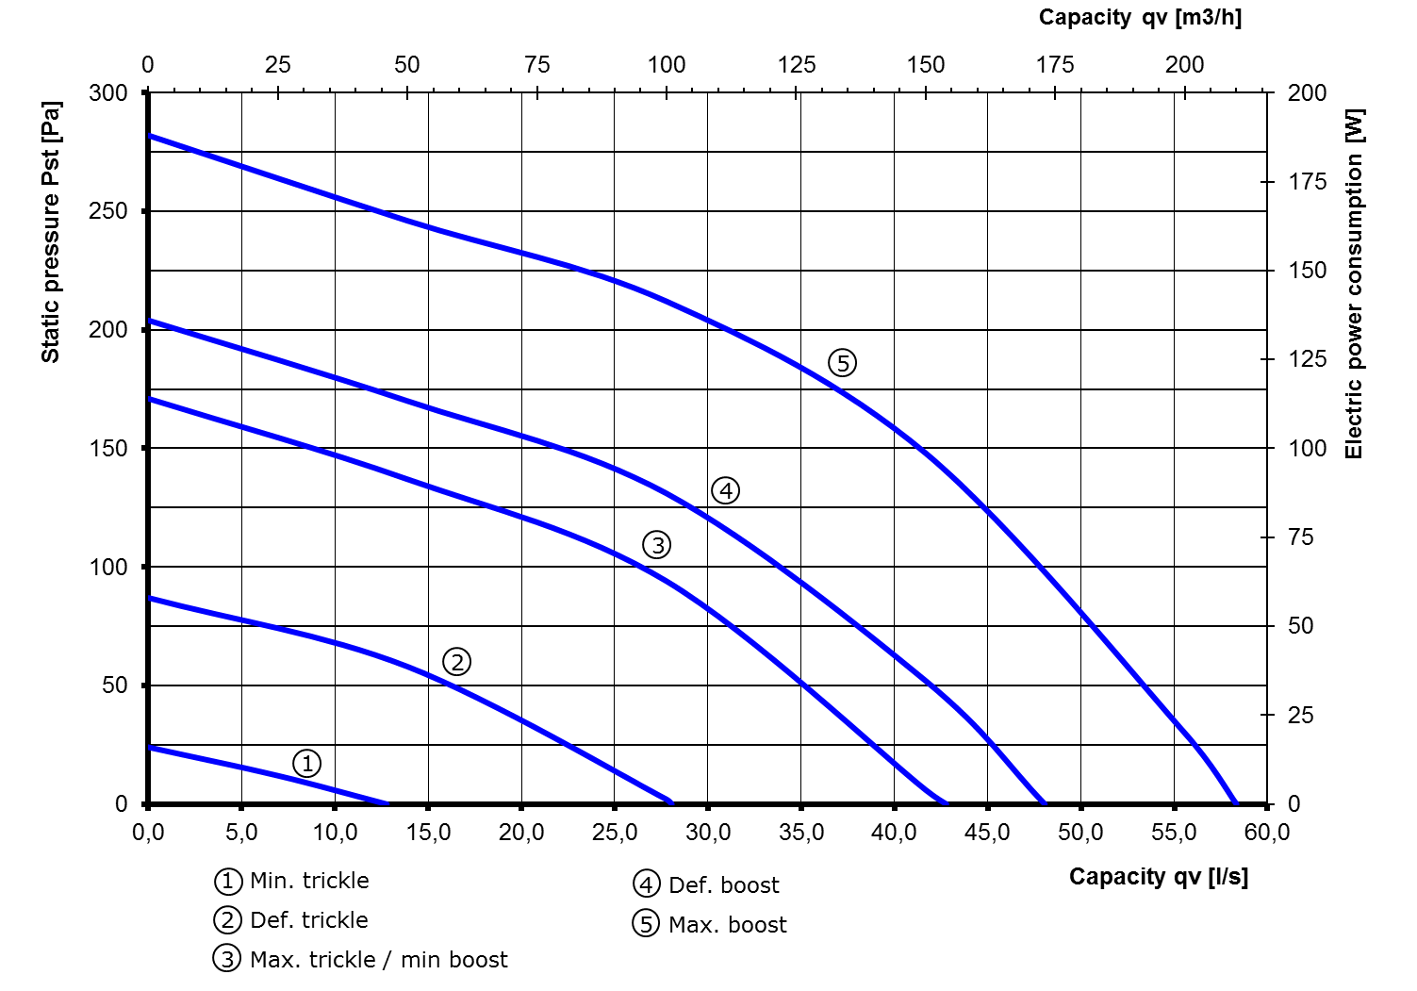
HRU ECO 150, performance

Slide 33
HRU ECO 150, inspection
Inspection | Schedule | User | Installer
Noise | Check variant noise from unit, ducting, grills | 6 months | 1 year
Filter G3 | Check degree of dirt | 1 week | -
Filter G4 | Check degree of dirt | 9 months | 1 year
Filter F7 | Check degree of dirt | 6 months | 1 year
Unit | Check degree of dirt and leaking condensate | 6 months | 1 year
Motor module | Check degree of dirt / imbalance | - | 1 year
Bypass valve | Check functionality / degree of dirt | - | 1 year
Grills | Check degree of dirt | 3 months | 1 year
Ducting | Check degree of dirt | - | 4 years

Slide 34
HRU ECO 150, maintenance
Maintenance | Schedule | User | Installer
Filter G3 | Cleaning ( first 3 months) Exchange for G4 or F7 | 1 week 3 months | If necessary
Filter G4 | Cleaning Exchange | 9 months 18 months | If necessary
Filter F7 | Cleaning Exchange | 6 months 12 months | If necessary
MVHR Unit | Cleaning outside housing | 3 months | 1 year
Condensate hose | Cleaning condensate hose | - | 1 year
Motor module | Cleaning | - | 4 year
Bypass valve | Cleaning | - | 1 year
Grills | Cleaning | 3 months | 1 year
Ducting | Cleaning | - | 8 years
Battery RF-control | Exchange battery | If necessary | If necessary

Slide 35
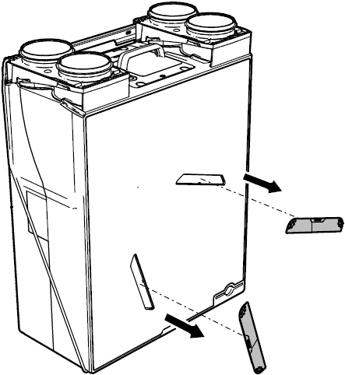
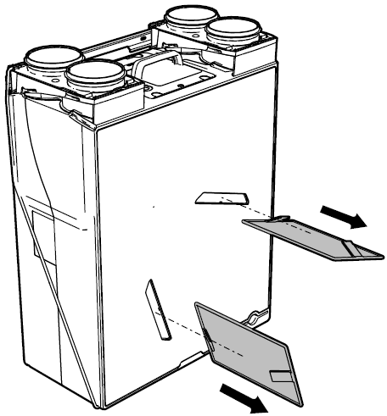
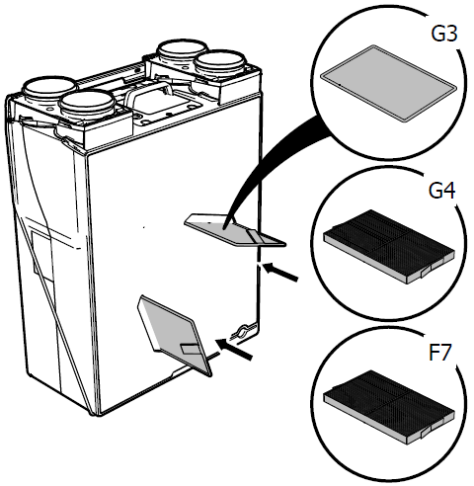
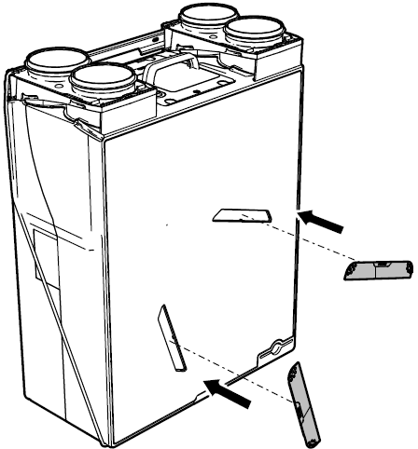
HRU ECO 150, maintenance / exchange of filters
Remove filter covers from front
Remove filters from unit
Clean or exchange filters (note: G4 and F7 filters have a different shape from G3 filter)
Insert the filters again
Insert filter covers again

Slide 36
HRU ECO 150, remove motor module
Unlock the duct connection and tilt the unit
Remove the 2 screws of the motor module
Remove the motor module with a rotating move

Slide 37
HRU ECO 150, remove bypass valve
Remove motor module (see previous sheet)
Remove yellow cable bracket from the foam part
Remove cable from cable tray in the foam
Remove bypass valve from foam part
(for this purpose there are 2 “finger holes” in the inside of the bypass valve)

Slide 38
HRU ECO 150, service parts
MOET NOG AANGEPAST WORDEN

Slide 39
End

